Slide 1
Heuristics in Query Processing

Slide 2
It is an activity conducted by the query optimizer to select the best available strategy for executing the query.
1. Query Trees and Heuristics for Query Optimization
Apply heuristic rules to modify the internal representation of the query
The scanner and parser of an SQL query first generates a data structure that corresponds to an initial query representation
It is optimized according to some heuristics rules
This leads an optimized query representation, which corresponds to the query execution strategy

Slide 3
Query tree is used to represent relational algebra, query graph is used to represent relational calculus
whereas a query graph is used to represent a relational calculus expression.

Slide 4
How heuristic optimization rules are applied to convert an initial query tree into an equivalent query tree,
which represents a different relational algebra expression that is more efficient to execute but gives the same result as the original tree.

Slide 5
Notation for Query Trees and Query Graphs
A query tree is a tree data structure that corresponds to a relational algebra expression.
It represents the input relations of the query as leaf nodes of the tree, and represents the relational algebra operations as internal nodes.

Slide 6
An execution of the query tree consists of executing an internal node operation whenever its operands are available and then replacing that internal node by the relation that results from executing the operation.
The order of execution of operations starts at the leaf nodes, which represents the input database relations for the query, and ends at the root node, which represents the final operation of the query.
The execution terminates when the root node operation is executed and produces the result relation for the query.

Slide 7
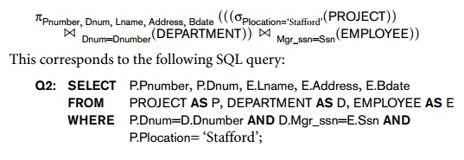
For every project located in ‘Stafford’, retrieve the project number, the controlling department number, and the department manager’s last name, address, and birthdate.

Slide 8
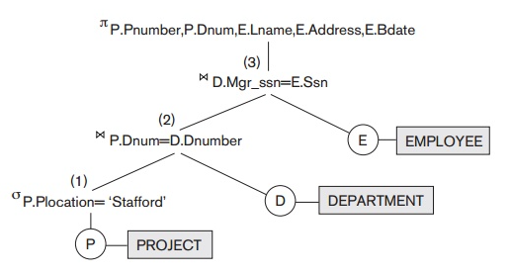
In Figure the leaf nodes P, D, and E represent the three relations PROJECT DEPARTMENT, and EMPLOYEE. The internal tree nodes represent the relational algebra operations of the expression.
When this query tree is executed, the node marked (1) in Figure must begin execution before node (2) because some resulting tuples of operation (1) must be available before we can begin executing operation (2). Similarly, node (2) must begin executing and producing results before node (3) can start execution, and so on.

Slide 9
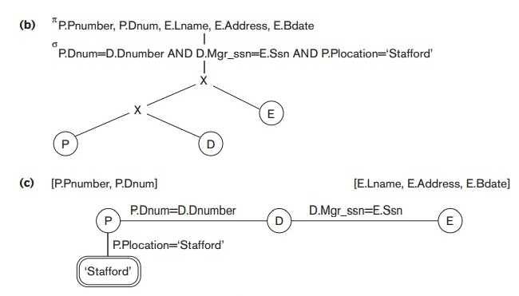

Slide 10
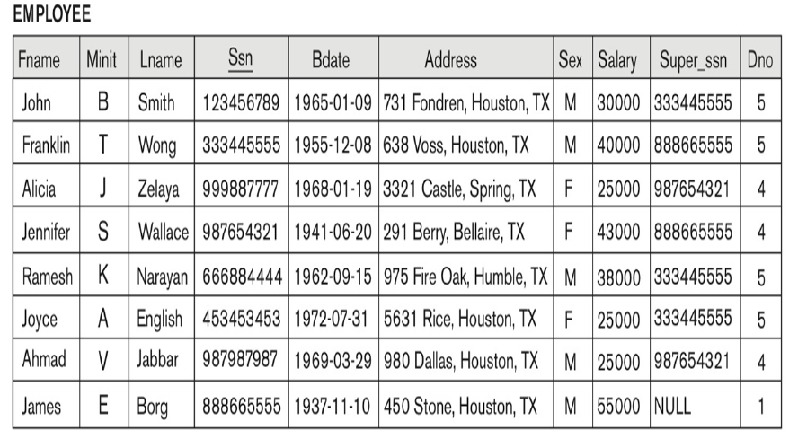
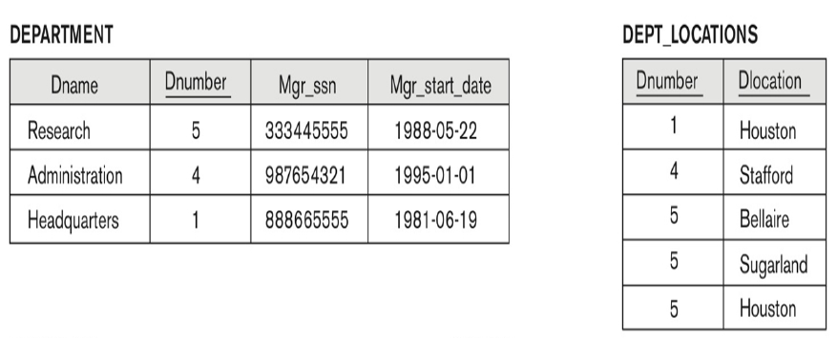

Slide 11
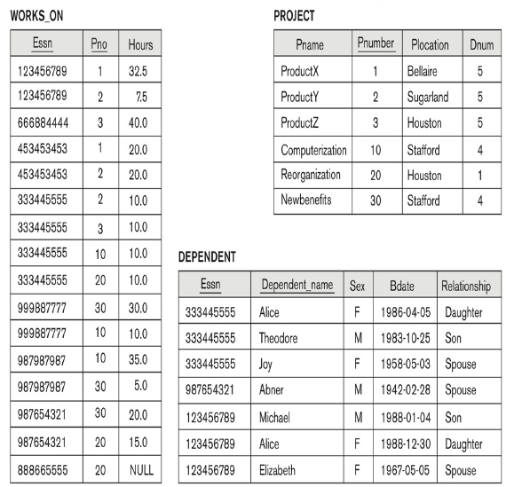

Slide 12
Heuristic Optimization of Query Trees
The query parser will typically generate a standard initial query tree to correspond to an SQL query, without doing any optimization.
The heuristic query optimizer will transform this initial query tree into an equivalent final query tree that is efficient to execute.

Slide 13
The optimizer must include rules for equivalence among relational algebra expressions that can be applied to transform the initial tree into the final, optimized query tree.
First we discuss informally how a query tree is transformed by using heuristics,
and then we discuss general transformation rules and show how they can be used in an algebraic heuristic optimizer.

Slide 14
Find the last names of employees born after 1957 who work on a project named ‘Aquarius’.
This query can be specified in SQL as follows:
SELECT Lname FROM EMPLOYEE, WORKS_ON, PROJECT Where Pname=‘Aquarius’ and Pnumber =Pno and Essn=Ssn and Bdate > ‘1957-12-31’

Slide 15
Steps in converting a query tree during heuristic optimization.
Initial (canonical) query tree for SQL query Q.
Moving SELECT operations down the query tree.
Applying the more restrictive SELECT operation first.
Replacing CARTESIAN PRODUCT and SELECT with JOIN
operations.
5. Moving PROJECT operations down the query tree.

Slide 16
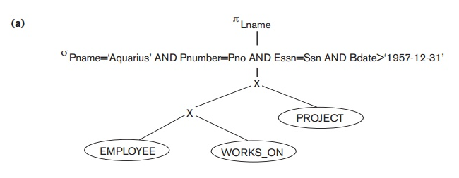
Initial (Canonical) Query tree for the given SQL

Slide 17
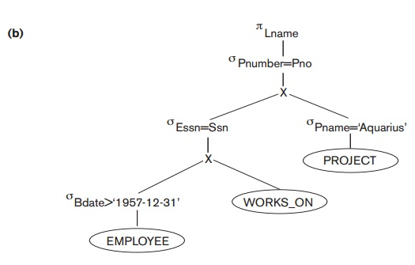
Moving SELECT operation down in the Query Tree

Slide 18
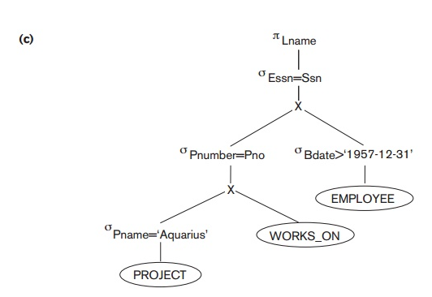
Applying more restrictive SELECT operation first

Slide 19
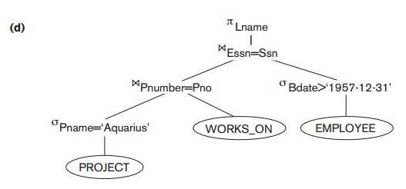
Replacing Cartesian Cross Product and Select with JOIN

Slide 20
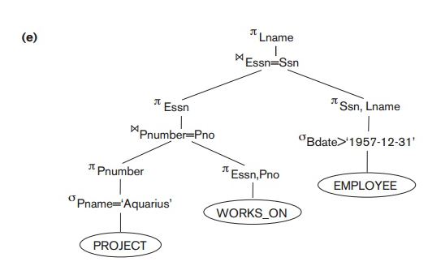
Moving PROJECT operation down the Query Tree

Slide 21
General Transformation Rules for Relational Algebra Operations
There are many rules for transforming relational algebra operations into equivalent ones.
For query optimization purposes, we are interested in the meaning of the operations and the resulting relations.
Hence, if two relations have the same set of attributes in a different order but the two relations represent the same information, we consider the relations to be equivalent.

Slide 22
General Transformation Rules for Relational Algebra Operations
1. A conjunctive selection condition can be broken up into a cascade of individual σ operations.
σ c1 AND c2 AND c3 (R) = σ c1 (σ c2 (σ c3 (R)))
2. Commutative of σ : The σ operator is commutative,
σ c1 (σ c2 (R)) = σ c2 (σ c1 (R))
3. Cascade of Π
ΠList1 (ΠList2 ……(ΠListn (R) ) = ΠList1 (R )
4. Commuting σ with Π If the selection condition c involves only those attributes A1, A2, …An in the projection list, the two operators can be commuted
Π<A1, A2, …An> (σ (R) ) = σ ( Π<A1, A2, …An> (R) )

Slide 23

5. Commutativity of and X
R S = S R
R X S = S X R
6. Commuting σ c with
If the attributes in the selection condition c involve only the attributes of the one of the relation being joined then
σ _{c} ( R S) = (σ _{c} ( R ) ) S
if the selection condition c is c1 AND c2, c1 involves only attributes in R and c2 involves only attributes in S then
σ _{c} ( R S) = (σ _{c1} ( R )) (σ _{c2} ( S ))
7. Commuting Π with
Suppose L = (A1, A2, …,An, B1, B2, ..Bn) where (A1, A2, …, An) are attributes of R
(B1, B2, …, Bn) are attributes of S,
If the join condition only involves attributes in L, then
Π_{L} (R _{c} S ) = ( Π<A1, A2, …An> (R) ) ( Π<B1, B2, …Bn> (S) )

Slide 24
8. Commutativity of set operations. The set operations union and intersection is commutative but difference is not
9. Associativity of JOIN, X, Union and Intersection: These are individually associative
(R φ S ) φ T = R φ (S φ T)
10. Commuting selection with set operations: the σ operation commutes with union and intersection
σ (R φ S ) = (σ (R)) φ (σ (S))

Slide 25
11. The Π commutes with union
ΠL (R U S ) = ( ΠL (R) ) U ( ΠL (S) )
12. Converting a σ and X sequence into a JOIN
σ_{c} (R X S) = (R _{c} S)
13. Pushing σ in conjunction with set difference
σ_{c} (R - S) = σ_{c} (R ) - σ_{c} (S)
However, selection may be applied to only one relation.
σ_{c} (R - S) = σ_{c} (R ) - S
14. Pushing σ to only one argument in ῃ
If in the condition σc all attributes are from relation R, then
σ_{c} (R ῃ S) = σ_{c} (R ) ῃ S
15. If S is empty, RUS = R

Slide 26
Outline of a heuristic optimization algorithm
1. Using rule 1, break up the select operation, this will allow moving selection down the tree at different branches
2. Using rules 2, 4, 6, 10, 13, 14 move each select operation as far down the query tree as is permitted by the attributes
3. Using rule 5 and 9, rearrange the leaf nodes
4. Using rule 12, combine X with a selection and JOIN
5. Using rule 3, 4, 7, 11 cascading of projection, breakdown and move down the tree
6. Reduce the size of intermediate results; perform selection as early as possible
7. Use projection attributes as early as possible to reduce number of attributes
8. Execute select and join operations that are more restrictive or result in less tuples

Slide 27
Cost components for query execution
1. Access cost to disk (disk I/O, searching for a record, access structures, hashing, indexes, file allocation methods, etc..
2. Disk storage cost: any intermediate file storage cost
3. Computation cost: CPU time (processing time), searching, merging, performing computations on fields, etc.
4. Memory usage cost: no of buffers
5. Communication cost: cost of shipping data from the source of query location to the server
Minimize access cost to disk…for large databases
For small database, it is stored in memory

